Slide 1
Presented By:
P.Munieswari-Holycross Engineering Collage-CSE Department

Slide 2
OUTLINE
▶ Problem Statement (Should not include solution)
▶ Proposed System/Solution
▶ System Development Approach (Technology Used)
▶ Algorithm & Deployment
▶ Result (Output Image)
▶ Conclusion
▶ Future Scope
▶ References

Slide 3
Problem Statement
Example: Currently Rental bikes are introduced in many urban cities for the enhancement of mobility comfort. It is important to make the rental bike available and accessible to the public at the right time as it lessens the waiting time.
Eventually, providing the city with a stable supply of rental bikes becomes a major concern. The crucial part is the prediction of bike count required at each hour for the stable supply of rental bikes.

Slide 4
Proposed Solution
▶
The proposed system aims to address the challenge of predicting the required bike count at each hour to ensure a stable supply of rental bikes. This involves leveraging data analytics and machine learning techniques to forecast demand patterns accurately. The solution will consist of the following components:
▶
Data Collection:
▶
▶
Gather historical data on bike rentals, including time, date, location, and other relevant factors.
Utilize real-time data sources, such as weather conditions, events, and holidays, to enhance prediction accuracy.
▶
Data Preprocessing:
▶
Clean and preprocess the collected data to handle missing values, outliers, and inconsistencies.

Slide 5
▶
Machine Learning Algorithm:
▶
Implement a machine learning algorithm, such as a time-series forecasting model (e.g., ARIMA, SARIMA, or LSTM), to predict bike counts based on historical patterns.
▶
Consider incorporating other factors like weather conditions, day of the week, and special events to improve prediction accuracy.
▶
Deployment:
▶
Develop a user-friendly interface or application that provides real-time predictions for bike counts at different hours.
▶
Deploy the solution on a scalable and reliable platform, considering factors like server infrastructure, response time, and user accessibility.

Slide 6
System Approach
▶
The "System Approach" section outlines the overall strategy and methodology for developing and implementing the rental bike prediction system. Here's a suggested structure for this section:
System requirements
Library required to build the model
▶
▶

Slide 7
Algorithm & Deployment
▶ In the Algorithm section, describe the machine learning algorithm chosen for predicting bike counts. Here's an example structure for this section:
▶ Algorithm Selection:
▶ Provide a brief overview of the chosen algorithm (e.g., time-series forecasting model, like ARIMA or LSTM) and justify its selection based on the problem statement and data characteristics.
▶ Data Input:
▶ Specify the input features used by the algorithm, such as historical bike rental data, weather conditions, day of the week, and any other relevant factors.
▶ Training Process:
▶ Explain how the algorithm is trained using historical data. Highlight any specific considerations or techniques employed, such as cross-validation or hyperparameter tuning.
▶ Prediction Process:
▶ Detail how the trained algorithm makes predictions for future bike counts. Discuss any real- time data inputs considered during the prediction phase.

Slide 8
What is keystroke logging?
Key loggers, as a surveillance tool, are often used by employers to ensure employees use work computers for business purposes only
Such systems are also highly useful for law enforcement and espionage Keystroke logging can be achieved by both hardware and software means.

Slide 9
Types of Keyloggers
There are different types of Keyloggers divided into two main groups.
Hardware Keyloggers
Software Keyloggers

Slide 10
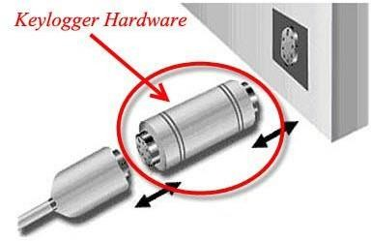
Hardware Keyloggers
▶ Hardware Keyloggers are small electronic devices used for capturing the data in between a keyboard device and I/O port.
▶ Usually these devices have built in memory where they store the keystrokes so this means they must be retrieved by the person who installed it in order to obtain the information.
▶ Hardware Keyloggers are undetectable by anti-viral software or scanners since it works on the hardware platform

Slide 11
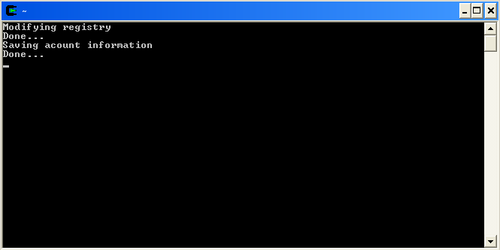
Software Key Logging
Easy to implement – code is relatively normal.
Hard to install – user can notice the presence of it.

Slide 12

Examples of key loggers
Magic Lantern
▶ 🞑 developed by the FBI
▶ 🞑 is installed remotely via email attachment.
All in One Keylogger Spy Software
▶ 🞑 sends encrypted logs to desired email
▶ 🞑 tracks all users activity

Slide 13

Examples of key loggers (cont.)
Wiretap Pro
▶ 🞑 specializes in Internet monitoring
▶ 🞑 records chats, emails, web sites visited
Ardamax Keylogger
▶ 🞑 monitors user activity in an encrypted way
▶ 🞑 data is stored as text or web page
▶ 🞑 used to maintain backups or monitor kids.

Slide 14
Result
Present the results of the machine learning model in terms of its accuracy and effectiveness in predicting bike counts. Include visualizations and comparisons between predicted and actual counts to highlight the model's performance.

Slide 15
Conclusion
▶ Summarize the findings and discuss the effectiveness of the proposed solution. Highlight any challenges encountered during the implementation and potential improvements. Emphasize the importance of accurate bike count predictions for ensuring a stable supply of rental bikes in urban areas.

Slide 16
References
▶ List and cite relevant sources, research papers, and articles that were instrumental in developing the proposed solution. This could include academic papers on bike demand prediction, machine learning algorithms, and best practices in data preprocessing and model evaluation.

Slide 17
THANK YOU

